Slide 1


Predicting Diabetes Risk Using Machine Learning: A Comparative Analysis
Welcome to this presentation on predicting diabetes risk using machine learning. We will delve into a comparative study of Logistic Regression, Random Forest, and XGBoost models to understand their efficacy in early diabetes detection.
by Irakam Siva Venkata Bhanu Prakash

Slide 2

Objective of the Project
Predict Diabetes Likelihood
Support Healthcare Professionals
Our primary goal is to develop and rigorously evaluate machine learning models capable of predicting an individual's likelihood of developing diabetes. This involves leveraging various health metrics to create a robust predictive tool.
The models aim to serve as a valuable resource for healthcare professionals, enabling them to identify high-risk individuals early. This early identification can lead to timely interventions and personalized care plans, improving patient outcomes.
Focus on Actionable Insights
We prioritize accuracy and interpretability in our model development. The insights derived from these models must be actionable, providing clear guidance for medical practitioners and patients alike, facilitating preventative measures and treatment strategies.

Slide 3

Dataset Overview
The foundation of our predictive modeling is the Pima Indians Diabetes Dataset, a well-regarded benchmark in medical research, sourced from the UCI Machine Learning Repository. This dataset provides a comprehensive collection of physiological measurements pertinent to diabetes.
The dataset includes several key features that are crucial for predicting diabetes onset. These features encompass various aspects of a patient's health profile, offering a holistic view for analysis.
Pregnancies: Number of times pregnant.
Glucose: Plasma glucose concentration a 2 hours in an oral glucose tolerance test.
BloodPressure: Diastolic blood pressure (mm Hg).
SkinThickness: Triceps skin fold thickness (mm).
Insulin: 2-Hour serum insulin (mu U/ml).
BMI: Body mass index (weight in kg/(height in m)^2).
Age: Age in years.
The target variable, Outcome, clearly differentiates between diabetic (1) and non-diabetic (0) cases, enabling supervised learning for our predictive models. This binary classification is central to evaluating our models' effectiveness.

Slide 4
Data Preprocessing
Effective data preprocessing is paramount for building accurate and reliable machine learning models. Our approach addressed several critical aspects of data preparation to ensure the highest quality input for our algorithms.
1
Handling Medically Implausible Zeros
2
Imputing Missing Values
Identified and replaced zero values in features like Glucose, BloodPressure, SkinThickness, Insulin, and BMI with NaNs. These zeros were determined to be medically implausible, as such readings would indicate a non-viable state.
Missing values, now represented as NaNs, were imputed using a median strategy. This method helps maintain the integrity of the dataset by replacing missing points with a robust central tendency measure, minimizing distortion from outliers.
3
Feature Scaling with StandardScaler
4
Train-Test Split for Robust Evaluation
Applied StandardScaler to normalize feature values. This step is crucial for algorithms sensitive to feature magnitudes, ensuring all features contribute equally to the model by transforming them to have a mean of 0 and a standard deviation of 1.
Divided the dataset into training and testing sets. This split allows for an unbiased evaluation of model performance on unseen data, providing a more accurate assessment of generalization capability and preventing overfitting.

Slide 5
Models Trained & Evaluation Metrics
We carefully selected three distinct machine learning models to provide a comprehensive comparative analysis of their performance in predicting diabetes risk. Each model offers unique strengths, from interpretability to high predictive power. It's Accuracy :
To thoroughly evaluate the performance of our models, we utilized a suite of standard classification metrics. These metrics provide a multifaceted view of each model's effectiveness, beyond just simple accuracy.
1
Logistic Regression - 0.71
Accuracy
Chosen as our baseline model due to its simplicity and high interpretability. It provides a clear understanding of the relationship between features and the probability of diabetes, serving as a fundamental benchmark.
Precision
Recall
2
Random Forest Classifier - 0.73
An ensemble learning method, Random Forest was selected for its ability to handle complex datasets and reduce overfitting. Hyperparameter tuning was performed to optimize its performance, enhancing its robustness.
ROC AUC Score
Confusion Matrix
3
XGBoost Classifier - 0.73
Representing an advanced boosting model, XGBoost was included for its reputation for achieving state-of-the-art accuracy in various machine learning tasks. Its optimized gradient boosting framework ensures high predictive power.
Precision-Recall Curve

Slide 6
Results & Comparison
Our comprehensive evaluation of the trained models revealed distinct performance characteristics for each. The results highlight the trade-offs between predictive power, interpretability, and specific metric optimization.
0.82
The visual representation of ROC and Precision-Recall (PR) curves for all models further reinforced these findings. The ROC curve for XGBoost consistently positioned itself higher and further to the left, indicating a superior true positive rate at various false positive rates. Similarly, the PR curves provided deeper insights into model performance, especially in the presence of class imbalance, where XGBoost and Random Forest showed stronger performance in maintaining precision while achieving high recall. These visualizations are critical for understanding the models' behavior beyond single-point metrics.
XGBoost ROC AUC
XGBoost consistently demonstrated the highest ROC AUC score, indicating its superior ability to distinguish between diabetic and non-diabetic individuals across various threshold settings. This makes it highly effective for risk prediction.
0.81
Logistic Regression Interpretability
Logistic Regression, while having a lower ROC AUC, proved to be the most interpretable model. Its coefficients directly indicate the impact of each feature on the likelihood of diabetes, offering clear actionable insights for clinical use.
0.81
Random Forest Balance
Random Forest struck a commendable balance between overall accuracy and recall. It effectively identified a significant portion of actual positive cases without an excessive rate of false positives, making it a robust choice for practical applications.

Slide 7
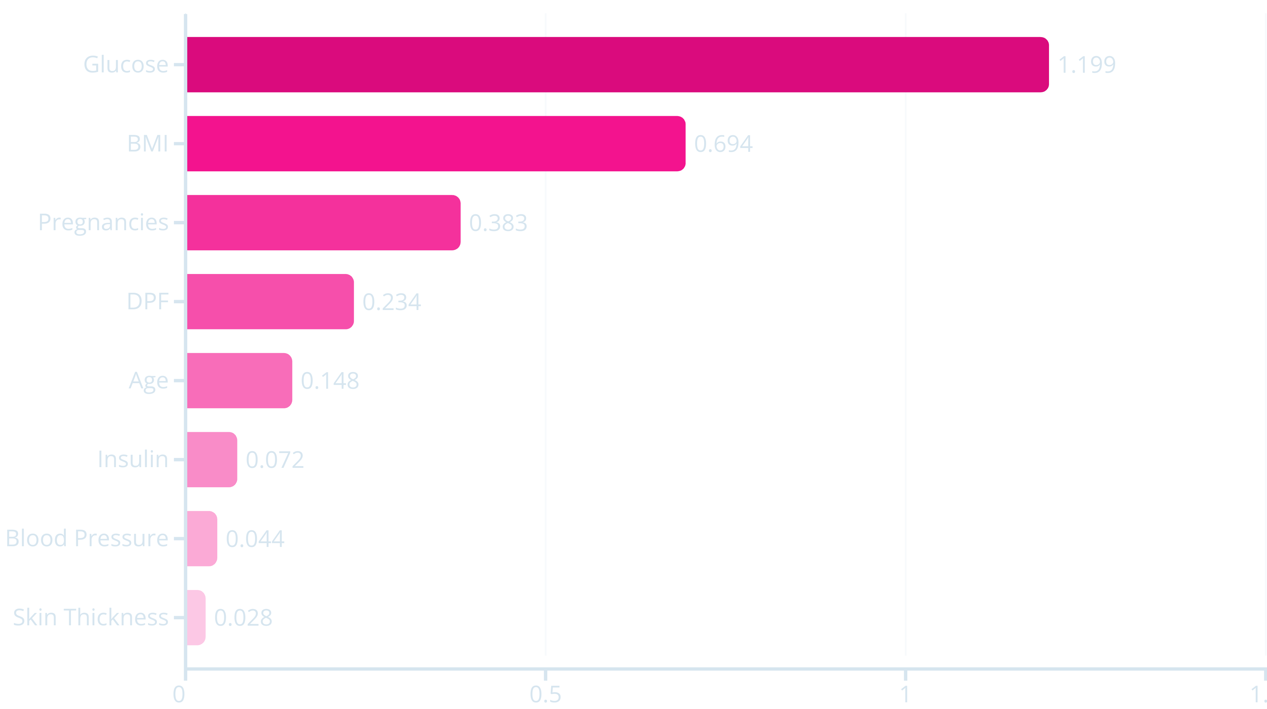
Feature Importance
Understanding which features contribute most to predicting diabetes risk is crucial for both clinical insights and model development. Our analysis consistently identified several key indicators that significantly influence prediction accuracy.
The bar chart above illustrates the relative importance of each feature. Glucose concentration emerged as the most critical predictor, closely followed by BMI (Body Mass Index). These findings align with established medical understanding of diabetes risk factors. Age also showed significant importance, reflecting its role as a general health indicator. While Insulin levels were also important, their contribution was less pronounced than Glucose and BMI. This hierarchical understanding of feature importance is crucial for clinical interpretation and for potentially guiding data collection efforts in future studies.

Slide 8
Key Insights & Limitations
Key Insights
Limitations
Our analysis yielded several critical insights regarding diabetes prediction using machine learning, highlighting both the most influential factors and the superior performance of advanced models.
While our models demonstrate significant potential, it's important to acknowledge certain limitations that could impact their generalizability and scope.
Missing Lifestyle/Hereditary Data
Glucose and BMI are Strong Indicators
The current dataset lacks crucial lifestyle factors (e.g., diet, exercise habits) and comprehensive hereditary information, which are known to be significant contributors to diabetes risk. Including these could further enhance predictive accuracy.
The study clearly demonstrated that Glucose concentration and Body Mass Index are the most significant predictors of diabetes risk. This underscores their importance in both screening and early diagnostic processes.
Moderate Class Imbalance
XGBoost's Superior Performance
Despite efforts to mitigate its effects, the moderate class imbalance in the dataset (more non-diabetic than diabetic cases) can still pose challenges, potentially affecting the models' ability to perfectly identify minority class instances.
The AUC-ROC curve analysis consistently showed that XGBoost outperformed other models, exhibiting superior predictive power and a better balance between sensitivity and specificity. This makes it an ideal candidate for high-stakes medical predictions.
Potential for Overfitting
Addressing Class Imbalance
Tree-based models like Random Forest and XGBoost, while powerful, inherently carry a risk of overfitting, especially with complex interactions between features. Careful cross-validation and hyperparameter tuning were employed to minimize this risk.
By optimizing for ROC AUC and recall, we effectively addressed the moderate class imbalance present in the dataset. This approach ensures that the models are not biased towards the majority class and can accurately identify positive cases (diabetes) even if they are less frequent.

Slide 9
Future Work & Conclusion
Future Work
Conclusion
Building upon the current findings, our future research will focus on expanding the scope and robustness of our diabetes prediction models through several key initiatives.
In conclusion, this comparative analysis underscores the significant potential of machine learning in revolutionizing early diabetes detection and patient care.
Address Imbalance with SMOTE/ADASYN
XGBoost: The Most Effective Model
To further combat class imbalance, we plan to implement advanced synthetic data generation techniques like SMOTE (Synthetic Minority Over-sampling Technique) or ADASYN (Adaptive Synthetic Sampling Approach). These methods will create synthetic samples for the minority class, ensuring a more balanced dataset and improving model performance on less frequent outcomes.
Our study unequivocally identifies XGBoost as the most effective model for predicting diabetes risk, owing to its superior performance across key evaluation metrics, particularly the ROC AUC score.
Predictive Analytics Guide Early Intervention
Collect More Features
The application of predictive analytics provides a powerful tool for guiding early intervention strategies. By accurately identifying high-risk individuals, healthcare providers can initiate preventative measures, leading to better health outcomes and potentially reducing the burden of diabetes.
Enhancing the dataset with additional features, such as detailed dietary habits, exercise routines, and comprehensive family medical history, will provide a more holistic view of an individual's health profile. This enriched data is expected to significantly improve the predictive power and clinical relevance of our models.
ML Models Augment Diagnostic Processes
Explore Deep Learning & Ensemble Stacking
Machine learning models are not intended to replace traditional diagnostic methods but rather to augment them. They serve as a valuable complementary tool, enhancing the efficiency and accuracy of diagnostic processes in healthcare settings, thereby empowering clinicians with data-driven insights.
We intend to investigate the potential of deep learning models, such as neural networks, for their capacity to learn complex patterns from data. Additionally, exploring advanced ensemble stacking techniques, combining multiple models, could lead to even more accurate and robust diabetes prediction systems.

Slide 10


Thank You!
Thank you for your attention. We hope this presentation provided valuable insights into the application of machine learning for diabetes risk prediction. Your engagement and questions are highly appreciated.
Contact Details
Q&A
Email: irakmsivabhanuprakasd@gmail.com
We now open the floor for any questions you may have. Please feel free to ask about any aspect of our research, methodologies, results, or future directions.
LinkedIn: https://www.linkedin.com/in/siva-venkata-bhanu-prakash
GitHub Repository: https://github.com/hynko431/Predicting-Diabetes-Risk-Using-Machine-Learning-A-Comparative-Analysis

